Slide 1
Guiding or Protecting Children Online: Assessing, Blocking or Self-Regulation in the Arab World
Corine Feghaly
Consumer Protection Senior Expert
Telecommunications Regulatory Authority (TRA), Lebanon
October 2012

Slide 2
AGENDA
Cyber Threats and International Best Practices
Analyzing Threats
Policies and Best Practices
Lebanese Efforts
Awareness Measures for the Community
Code of Practice for Internet Service Providers
Internet Cafes Standardization
Influencing Children
Measures Targeting Parents

Slide 3
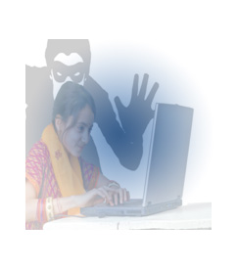
Cyber Threats
Threats identification (ITU guide, 2009)
Films and Sites that affect ethics and personality
Online Fraud
Child pornography
Violence
Online Gaming & Addiction
Illegal Gambling
Insults and Labeling
Identity Theft
Racism
Cyber-bullying

Slide 4
Policies and Best Practices
European Parliament and ITU recommendations
Create Public awareness in matters concerning the protection of children in Cyberspace, with a clear definition of policies, best practices, tools and necessary resources needed to adapt and use in each country
Take actions to enable minors to make responsible use of audiovisual and on-line information services by improving the level of awareness among parents, teachers and trainers
Draw-up a code of Practice in cooperation with professionals and regulatory authorities at national and Community level and support efforts aimed at developing guidelines on the online child protection by policy makers and regulators
Adopt a quality label for service providers, so that users can easily check whether or not a given provider subscribes to a Code of Practice
Examine the possibility of creating filters which would prevent information offending against human dignity from passing through the Internet
Identify risks and vulnerabilities faced by children in cyberspace as ICT technologies (Internet and other electronic resources) are in permanent ongoing expansion

Slide 5
Lebanese Children Protection Efforts
Community
Parents
School Presentations dedicated for parents
Children
ISPs/ Internet cafes
Standardization of Internet Cafes
TV and Radio Campaign
Dedicated National Website
Informative TRA Website Section
Roundtables
Conferences Contributions
Social Media
Parents/Children Contracts
Changes in schools curriculum
National hotline
Code of Practice for ISPs
The E-Ambassador program (peer influence is highest)

Slide 6
Community Awareness Measures
Awareness is a critical tool to protect children online and develop a knowledgeable society
Have taken steps to promote children’s online protection by hosting round tables and convening internet service providers, software vendors, and NGOs to share visions of online protection, discuss measures to implement, and provide recommendations.
Are offering information on children’s protection on its website (www.tra.gov.lb) which is consistently being updated with latest tools and information.
Have made several contributions to local, regional, and international conferences and workshops dedicated to all aspects of online child protection in Lebanon, such as legislative, technical, and regulatory issues.
Are developing an Informative and Interactive national Website/Blog ( 4 languages ) along with the necessary Social Media supporting this website, With the MOT .
Are developing a TV and media campaign to kick off the awareness and discussion in the community, With the MOT

Slide 7
Efforts Towards a Code of Practice for ISPs
The TRA is working on a Code of Practice for Internet SPs in collaboration with AREGNET, the MOT, the Higher Council for Child Protection (HCCP) and the ISPs. The HCCP has already dedicated committees for COP including:
Technical committee
develops recommendations on technical solutions (although no final recommendations have been issued yet)
Media committee
awareness campaigns
guidance and direction for parents and educational institutions
social developments that focus on online risks that children face and the best ways to address them
Legal Committee
converts suggestions/recommendations on threats facing children online to the binding legal texts of laws, decrees and other legal/administrative means
The TRA is now assessing AREGNET members’ feedback on a first draft of a proposed Code of Practice for Internet Service Providers, after having incorporated a survey that gathered AREGNET members feedback on risks and gaps

Slide 8
Efforts Towards Developing a Code of Practice for ISPs Proposed Framework
Awareness
Finalize Code of Practice for Internet Service Providers
Monitor implementation
Brief ISPs and operators on MOT and TRA initiatives and projects in terms of internet safety
Brief concerned NGOs and ministries (World Vision, Scouts, Himaya, MOEHE, Ministry of Social Affairs, Ministry of Interior…)
Set final requirements from Internet Providers to include at minimal: Providing tools, pointing to national website, updating their website with internet safety awareness and influencing internet cafes for responsible use (mainly for ISPs)
Partner with MOT to finalize Code of Practice
Follow up for signature with 17 ISPs and 2 Mobile Operators
TRA/MOT yearly check before License renewal with constant modifications on Code of Practice whilst benchmarking with national changes and best practices
Plan and implement Press conference
Implement, support and Monitor
Sign Inter-ISP agreement with internet providers
Lebanese Internet Service Providers Facts, today:
Some ISPs have dedicated Parental Control systems that are promoted on their WebPages (at Symbolic fees or free of charge)
Others give tips and hints for parents about buying and downloading children protection tools

Slide 9
Efforts Towards Influencing Internet Cafes
Aim at influencing Internet Cafes with the cooperation of municipalities by means of standardization, requiring them to:
Abide by enforced laws and Secure areas designated for the use of children and minors
age verification
identity check
content filtering and text analysis
Checking contents to be used by children
Maintain stored data and traffic data information and log use in a safe place for a "specific" period of time
Provide direct access and necessary facilities "to those legally entitled to” personnel (having permission according to proper judicial process)
Ensure that personal data is appropriate, accurate, updated and addressed according to the legal manner and treated in accordance with personnel data rights
Take all measures to protect against unauthorized access such as manipulation / loss of personnel data
Protect the privacy of personal information collected from monitoring the use of children
Agree to a contractual obligation in which they comply to applied rules related to dealing with data and ensure that above arrangements exist and are in place

Slide 10
Efforts Targeting Children
TRA is also currently working on a project with the MOT for a train the trainer project for young ambassadors to share their knowledge within their communities
Evaluate Level of knowledge on online safety
Design the train the trainer program
Implementation
Hold discussion groups to evaluate levels of knowledge among 5 schools in the different areas of Lebanon and gather information on safety tools for implementation in the community
Benefit from the Education Center at MOEHE survey experience in public schools on COP
Set requirements for a training model (development, implementation and evaluation phase)
Partner with key NGOs to create the training model
Develop funding proposal for implementation
Select, train and support 1000 E-Ambassadors
Hold a roundtable with community stakeholders (ISPs, Internet Cafes, NGOs, municipalities…), concerned ministries (Education, Social Affairs, Interior…) and media to continuously support ambassadors, to support new hotline and to support curriculum additions on COP
Monitor implementation, report progress and evaluate awareness level improvement
Identify online risks and gaps
Select training model
Implement, support and Monitor

Slide 11
Efforts Targeting Parents (1)
TRA believes parents are key influencers of children behavior online
The TRA has made several contributions to schools and dedicated parents workshops covering all tools that can be used by parents to ensure their children with a safe environment whilst surfing the net.
KIDS' SEARCH ENGINES
http://www.ajkids.com
http://www.yahooligans.com
http://www.kidsites.com
http://www.kidsclick.org
TIME-LIMITING TOOLS
- http://www.cyberpatrol.com
Allows restricted access to site and limits time on the Internet
- ENUFF Parental Control
Allows parents or teachers to monitor a child's activity on the computer, control access to the Internet, and determine times that children are allowed to use the computer
BROWSERS FOR KIDS
http://kidrocket.org/
http://www.kidzui.com/
http://www.buddybrowser.com
FILTERS
- Filters that use a preselected list of sites
- Filtering using human-maintained lists
- Keyword-based filters
- PICS-based filters
- Voluntary Labeling & Rating Systems

Slide 12
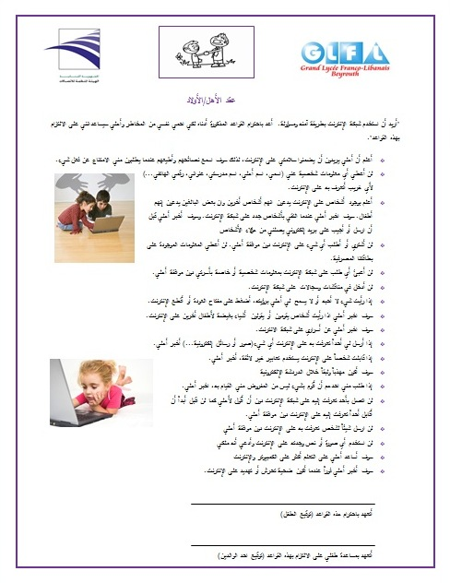
Efforts Targeting Parents (2)
In addition to peers, parents are key influencers of children behavior online
The TRA has created and distributed parents/children contracts in 3 languages (English, French and Arabic) to be shared amongst them as a binding commitment towards the usage of the internet at home and in the community.
“Parents need to be aware of the options they have to secure their internet at home,
they need to understand the potential risk areas and be able to educate their kids and monitor them accordingly. Although parents are the weakest channel to drive awareness for their kids , they still provide an important role to support their kids in case something happened and also they are the provider of access and can extend that to tools to be used at home.”

Slide 13
THANK YOU
(c) TRA- Lebanon Proprietary

