Slide 1
Liberalization of Telecom A Catalyst for Regional Development
The 9th Arab Telecom and Internet Forum
Habtoor Grand Hotel
15 -16 April 2009
Dr. Kamal Shehadi
Chairman and CEO
Telecommunications Regulatory Authority

Slide 2
Status of telecommunications in Lebanon
Needs of un/underserved areas
Options for ubiquitous coverage

Slide 3
Most telecommunications markets in Lebanon are stagnant and suffer from lack of competition
Main Markets
Penetration
Number of SP
Private / State-owned
Level of Competition
Mobile
35%
2
State-Owned
Monopoly
Fixed
67% ^{(*)}
1
State-Owned
Monopoly
Internet
32.5% ^{(*)}
~ 16
Private
Competition
ADSL
~ 11% ^{(*)}
~ 8
MoT / Ogero
(bitstream, line sharing)
Limited Competition
(*) per household
Currently MoT is the only provider of national internet and data transmission, however the network needs upgrade
MoT is planning for an expansion of the transmission and local loop network - complete in 2011
DSL services have experienced a significant growth in 2007, capturing almost 10% of the internet market within the first six months of the launch date but still low in penetration rate compared to the 67% coverage of the fixed service
The UN e-readiness Index for 2008 ranks Lebanon 76 out of 193 countries in the level of infrastructure development and readiness

Slide 4
Although fixed line penetration is 67%, there is a big gap between the different regions
Fixed Market
In 2005, household fixed penetration rate in the Beirut and Mount Lebanon area was quite high compared to the north, south and Bekaa regions
Nationwide fixed line penetration has increased from 58% to 67 % from 2005 to 2008; however we estimate that regional disparities still exist and are comparable to the situation in 2005
Source: TRA Market Analysis
ADSL Market
2009 | Number of COs with DSL
Beirut | 10
Mt Lebanon | 20
Nabatieh | 2
North | 13
South | 6
Source: TRA Market Analysis

Slide 5
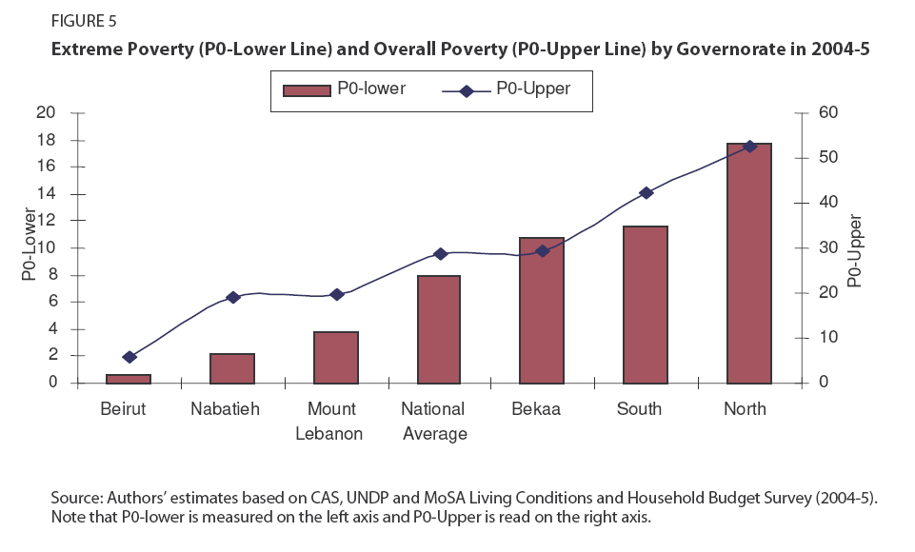
Regional disparities in income are significant and the poorest regions are able to spend very little on telecom
52% of households in Lebanon have an income of less than 1,000,000 LBP per month (source: CAS)
People spend 3 to 5% of their income on telecom services
59% of households in Lebanon can afford less than 8.75 USD per capita on telecommunications
The greatest % of households below the extreme poverty are in the North and they are the least able to spend on telecom
Percentage of households | Household Income in USD | Telecom Spending per household | Telecom Spending per capita
8% | <200 | 7 | 1.75
28% | 200-400 | 14 | 3.5
15% | 400- 600 | 21 | 5.25
8 % | 600 - 800 | 28 | 7
9% | 800-1000 | 35 | 8.75
8% | 1000-1600 | 56 | 14
4% | 1600-2200 | 77 | 19.25
2% | 2200-3400 | 119 | 29.75
1% | >3400 | 119 | 29.75
The above estimation is based on a calculation of 3.5% telecom spending of total GDP and an average of 4 residents per households
Sources: Central Administration of Statistics, TRA analysis
Source: UNDP Poverty Report 2008

Slide 6
Status of telecommunications in Lebanon
Needs of un/underserved areas
Options for ubiquitous coverage

Slide 7
Integration in the national economy entails decentralization and the development of economic activities and social services
Growth of Local SMEs
Telecommunications, transport, and energy networks link the major areas of a country and serve to integrate them into a national and, subsequently, an international economy
Economic Development
Integration in the National Economy
Job Opportunities
Environmental Quality
Government Services
Human Capacity &Potential
Health and Education
Services
Work Conditions

Slide 8
Mobile telecommunications, for example, has changed the lives of people and foster economic growth
Telecommunications transforms life styles – lessons from Mobile
Because of its availability, affordability and convenience, mobile telephony has produced in less than a decade the same impact that fixed line phones achieved in a century.
In Mongolia, young people have taught their parents enough English words to be able to read text messages and reply to them, so they can be in touch with their sons and daughters.
In Uganda, the leading cellular operator understood well that its customers could learn and enjoy SMS texting long before using the Internet.
The spread of mobile phone access, and the low unit cost of SMS text messages, is enabling dramatic changes in the retail and wholesale pricing, marketing and distribution of agricultural goods in a large number of developing countries. Farmers were able to get the market price of farm products using SMS, well before they learn how to use a computer.
In Kerala the spread of mobile phones among fishing fleets is transforming fish marketing, reducing wastage and price volatility, improving profits of the fishermen, and reducing consumer prices.
Responding to these changes, a wide range of entrepreneurs and innovators are providing new mobile-based tools and services for these markets such as m-banking.
The Philippines (which has a very large number of nationals working overseas and wishing to send remittances home) has been a leader in this field, with two well-known services, SMART Money and GLOBE G-Cash, currently serving over 3 million people.

Slide 9
ICT networks enable delivery of information, goods and services that stimulate economic growth and help domestic businesses compete globally
Deploying broadband services provides numerous benefits to developing countries, particularly in rural and remote regions
Economic development: Research suggests that telecommunications lead to economic growth. Communities without an adequate telecom infrastructure may be unable to participate and thrive in the 21st-century economy.
Access to information and resources: Broadband technologies enable rural and remote communities to overcome geographical constraints and gain access to regional and worldwide social, political, economic and financial information and resources.
Increased knowledge and expertise: The Internet provides access to online training and information that can help rural and remote communities provide better healthcare, education and other social services, while also improving local economies.
Greater market opportunities: With broadband access, community members can access geographically remote markets, increasing their business by establishing a wider range of potential buyers.
Improved business productivity: Internet-related services such as e-mail and VoIP enable local businesses to lower costs and improve revenues.
Growth of regional and national economies: A 2006 UN report estimates that broadband will contribute hundreds of billions of dollars a year to the GDP of developed countries in the next few years.

Slide 10
Telecom services can be a major driver of reduced regional economic disparities
Millennium Development Goals for reducing world poverty - Goal 8
Developing a global partnership for development
New Technologies – availability and benefits
Privatization
Accelerating Privatization of a number of public services, will increase productivity, acquire modern technology, attract foreign investment and assist in reducing public debt
European Commission programs and recommendations
1- e-EuropeRegio : the Information Society at the service of regional development
2- Commission earmarks €1bn for investment in broadband in rural areas:
Rationale:
Investment in broadband has a positive impact on economic development, innovation and territorial cohesion
broadband will help create around 1 million jobs in Europe and growth of € 850 bn between 2006 and 2015
The types of operations that can be supported are:
- Creation of new broadband infrastructure including backhaul facilities (e.g. fixed, terrestrial wireless, satellite-based or combination of technologies);
- Upgrade of existing broadband infrastructure;
- Laying down passive broadband infrastructure (e.g.: civil engineering works such as ducts, and other network elements such as dark fibre, etc.) also in synergy with other infrastructures (energy, transport, water, sewerage networks etc.)

Slide 11
WSIS established in 2005 internationally agreed-upon development goals to help countries overcome the Digital Divide
1
Connect villages with ICTs and establish community access points
2
Connect universities, colleges, secondary schools and primary schools with ICTs
4
Connect public libraries, cultural centers, museums, post offices and archives with ICTs
3
Connect scientific and research centers with ICTs
5
Connect health centers and hospitals with ICTs
6
Connect all local and central government departments and establish websites and email addresses
7
Adapt all primary and secondary school curricula to meet the challenges of the Information Society, taking into account national circumstances
8
Ensure that all of the world’s population has access to television and radio services
9
Encourage the development of content and put in place technical conditions to facilitate the presence and use of all world languages on the Internet
10
Ensure that more than half the world’s inhabitants have access to ICTs within their reach
Source: International Telecommunications Union

Slide 12
Status of telecommunications in Lebanon
Needs of un/underserved areas
Options for ubiquitous coverage

Slide 13
Competition and universal service policies are the key to meeting the demands of underdeveloped regions
Ubiquitous Coverage
Policy makers need to concern themselves with two separate gaps to help make rural communications services more viable.
The market efficiency gap – is caused by policies and regulations which limit the amount of investment and operator motivation present in the market. Competition, a level playing field, fair and cost-based interconnection, tariff reform, liberal service retailing regulations all contribute to network expansion into rural areas. These must be applied before any special incentives or subsidization need be considered
Liberalization of telecom Market
Universal Service
Competition
The real access gap – represents people and places that will not be reached even if policy and regulation is supportive of market efficiency and operator motivation. These places will need special intervention in the form of either a short term ‘smart subsidy’ or a longer term operating subsidy, through a universal access fund

Slide 14
Most developed countries are currently debating whether broadband should be included in universal service
Universal Service Policies
Universal service is a regulatory intervention that aims at providing subsidies for infrastructure deployment in rural and remote areas generally deemed uneconomic because subscriber revenues alone cannot cover service costs
Funds are collected revenues from a variety of sources (general tax revenues, government budgets, contribution from service providers or telecom operators and licenses)
Subsidies are provided usually to the incumbent operator deemed the universal service provider
The Lebanese Context
Article 26 of the telecom law describes the rights and obligations of the TRA and licensees to ensure the universal provision of telecommunications services in Lebanon
The TRA should establish a plan for licensing public telecommunications services in a way to ensure the availability of such services to all nationals and residents in all regions of the country
Public telecommunications licenses should specify the obligations to provide universal geographic coverage, voice services, directory services, emergency calls, and alternatives to users who do not need extensive use of such services
Licensees may recover, through arrangement with the TRA, the actual costs incurred in meeting license obligations related to universal service
In the event that such mechanisms are not efficient TRA may establish a universal service fund, financed through mandatory contributions imposed on other public telecommunications service providers

Slide 15
The TRA is minded to liberalize telecommunications markets and provide a solid regulatory framework to attract investors
 |  | 2009 | 2010 | 2011 | 2012 | 2013 | 2014
Mobile | Network Operator
 | Virtual Network MNVOs
PSTN/ Basic Telephony | Network Operator
 | Reseller and VoIP
Broadband | Access (BAL)
 | National (core, metro and access) (NBL)
International Gateway | Voice and Data Facilities Based Provider
 | Data Only Facilities Based Provider
 | Voice and Data Resellers
*
**
3
1
?
?
2
3
***
****
2
Open licensing
Market Review
License Award
* The privatization of the mobile sector will depend on the regional and international financial markets conditions
** Two mobile operators and Liban Telecom
*** Two mobile operators and Liban Telecom
**** Two National Broadband Licenses, subject to CoM’s decision

Slide 16
Broadband licensing is designed to attract investments and introduce efficient and fair competition to the broadband market
International Auction for two players: local and international participants
Auction includes access frequencies and license
NBL
Incentives to deploy a high capacity core network by providing him exclusivity on the core for three years
Can provide all kind of services (given the exclusivity period of Liban Telecom)
International auction for broadband access licenses with frequencies
BAL
Incentives for existing service providers to continue operation and acquire more frequencies
Open licensing regime for broadband access licenses without frequencies (whether wireline infrastructure or service based licenses)
Can provide any service (subject to the limited exclusivity period of Liban Telecom)

Slide 17
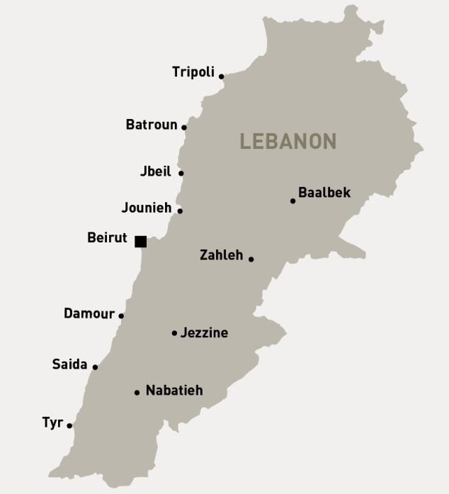
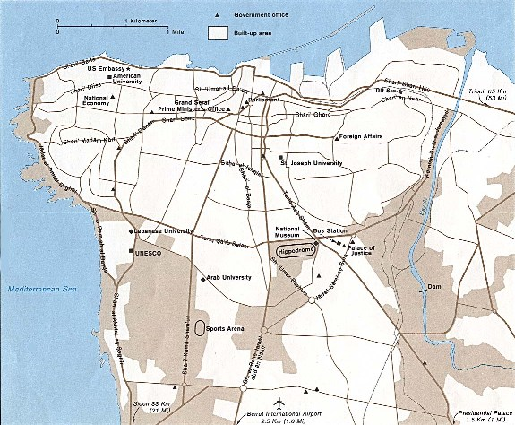
The NBLs will ensure high speed connectivity between the major towns, whereas BALs will ensure competition in access to broadband services all over Lebanon
Core and International
Metropolitan
Access
TRIPOLI
RasBeirut
Achrafieh
RasBeirut
User1
BEIRUT
BEKAA
Mazraa
Sin El Fil
User3
User2
SAIDA
Liban Telecom
National Broadband Licenses
Liban Telecom
National Broadband Licenses
Some Broadband Access Licenses
Liban Telecom
National Broadband Licenses
Broadband Access Licenses

Slide 18
Summary of the main regulations and decisions prepared by the TRA
Drafting Stage
Draft Ready Stage
On going Consultation
Closed Consultation
Final Review (TRA Board)
Issued
Significant Market Power Regulation
Access to the Local Loop Regulation
VOIP Policy Statement
Study on the Use of Public Property
Spectrum Refarming and Packaging Plan
Liberalization Roadmap
Decisions:
VSAT,
Trial IPTV
Spectrum trial Allocation for MoT / OGERO
Accounting Separation Regulation
National Roaming
Broadband Policy Statement
Improving FM Broadcasting
Code of Practice for Value Added Services
Universal Service
Digital Migration Strategy for TV Broadcasting Plan
Licensing
Regulation
CS / CPS
Study on the Right to Use Fees for Spectrum
Interconnection Regulation
Pricing Regulation
Access to Information Regulation
Interconnection Interim Pricing Decision
Type Approval Regulation
Quality of Service Regulation
Spectrum Pricing Opinion
Decision for establishment of call centers
Spectrum Management and Licensing Regulation
Lebanese National Frequency Table
Consumer Affairs Regulation
National Numbering Plan
Numbering Regulation

Slide 19
Thank you! www.tra.gov.lb

